Slide 1
Medical Genetics
Afnan Salaka
PhD Medical Genomics and Genetics
Aiman Alsaegh
PhD Molecular Diagnostics

Slide 2
Course Overview …. Theory
13 Theoretical Lectures
Case Study and
PBL sessions
3. Chromosomal abnormalities
1. Chromosome, DNA, Gene, Genome
4 & 5. Cytogenetic Tech.
2. Genomic Variations
13 Integrated Med. Gen.
6. Mendelian Disorders
7. Complex Disorders
8,9&10 Molecular Tech.
11 Prenatal Diagnosis
12 Precision Medicine

Slide 3
Course Overview …. Practical
Starts on week 11 and 12
Primer Design
DNA Extraction
Amplification
Visualization

Slide 4
Course Overview …. Evaluation
PBLs
Mid term Exam
Assignment
Oral Exam
Week 3, 7, 10, 14
Week 8
20/10/19
Week 15
8/12/19
Week 16
15/12/19
10 Marks
25 Marks
5 marks
5 Marks
Final Exam
(ASSAY)
Week 17-18
22/12/19
55 Marks

Slide 5
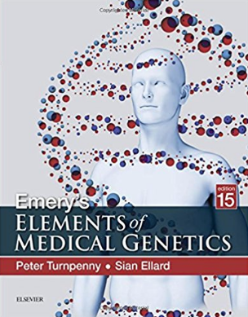
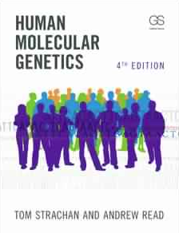
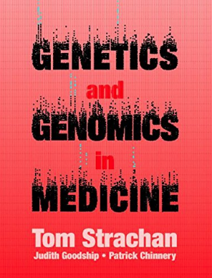
Course Overview …. Recomended Reading
Slide will be enough!

Slide 6
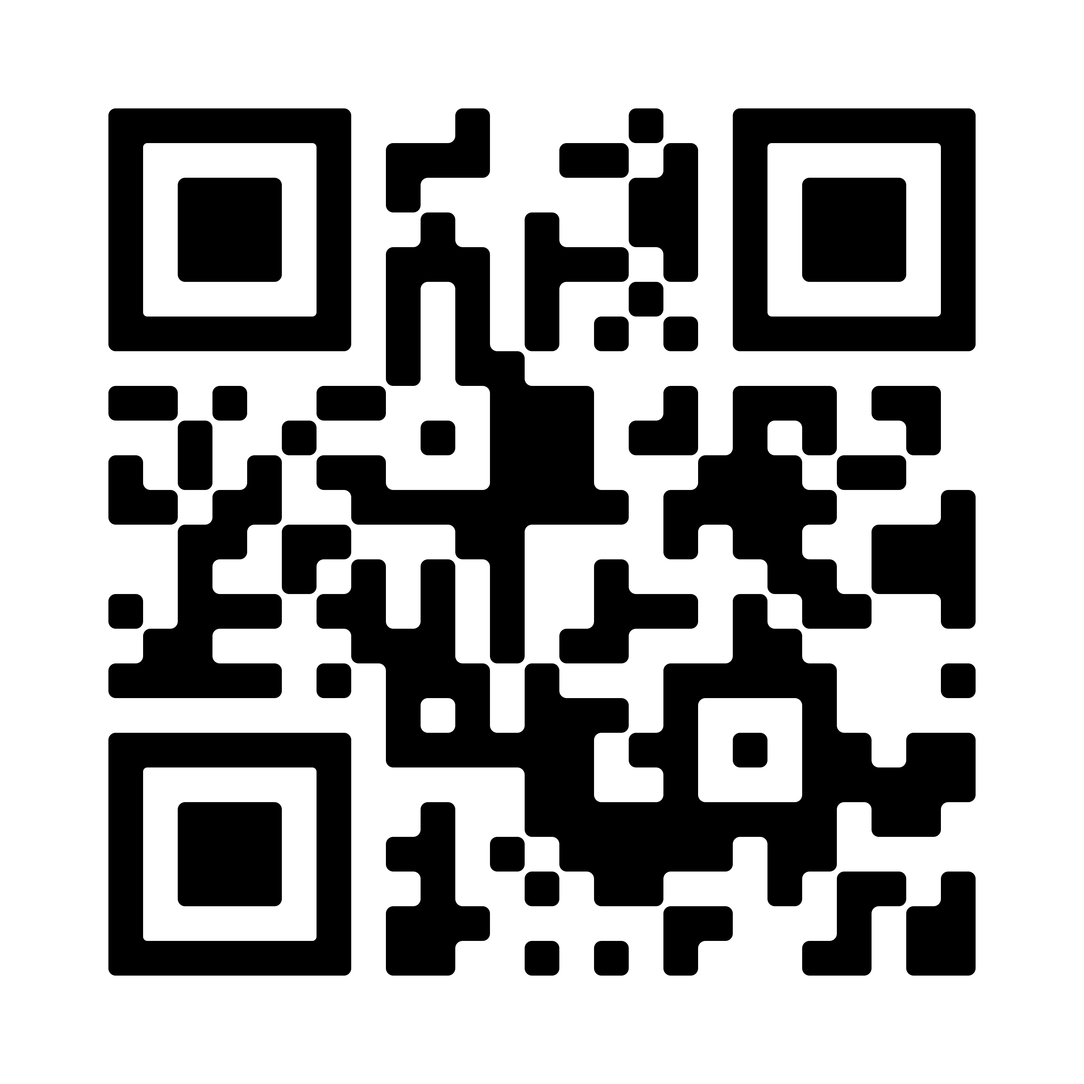
Course Overview ….
To download and print the course overview .. Scan the QR code below:

Slide 7
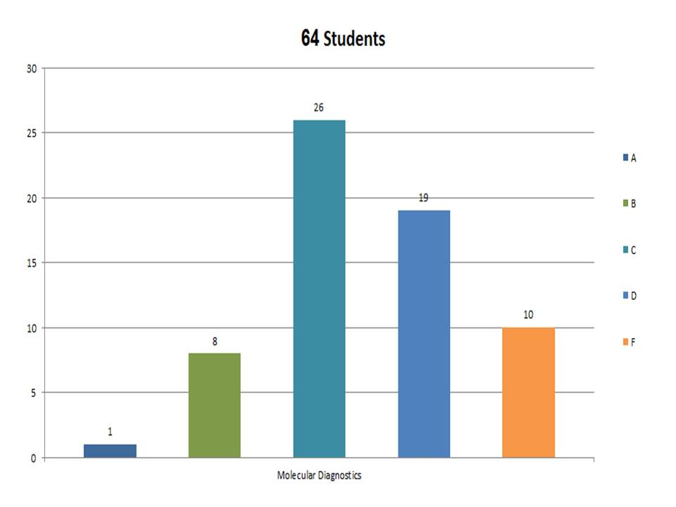
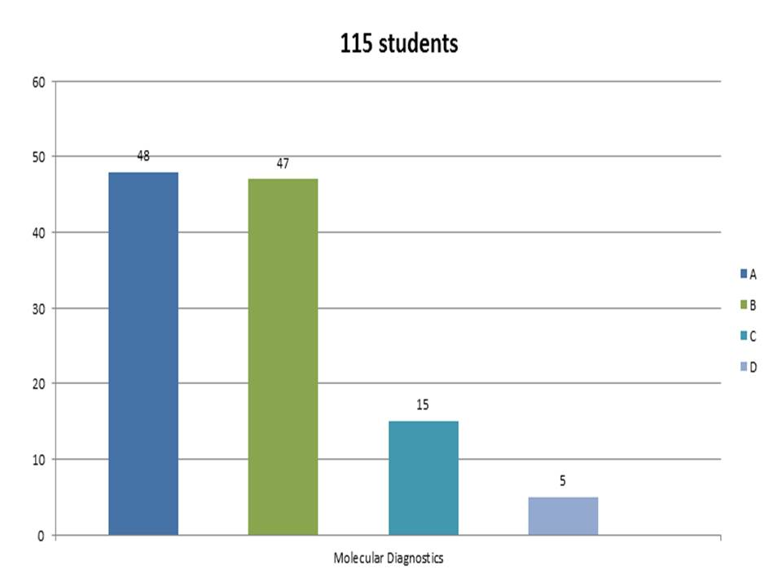
Is it a difficult course?

Slide 8
Medical Genetics
Afnan Salaka
PhD Medical Genomics and Genetics
Aiman Alsaegh
PhD Molecular Diagnostics

Slide 9
Course Overview …. Theory
13 Theoretical Lectures
Case Study and
PBL sessions
1. Chromosome, DNA, Gene, Genome
6. Mendelian Disorders
7. Complex Disorders
2. Genomic Variations
8,9&10 Molecular Tech.
3. Chromosomal abnormalities
11 Prenatal Diagnosis
4 & 5. Cytogenetic Tech.
12 Precision Medicine
13 Integrated Med. Gen.

Slide 10
Course Overview …. Practical
Starts on week 11 and 12
Primer Design
DNA Extraction
Amplification
Visualization

Slide 11
Course Overview …. Evaluation
PBLs
Mid term Exam
Assignment
Oral Exam
Week 3, 7, 10, 14
Week 8
20/10/19
Week 15
8/12/19
Week 16
15/12/19
10 Marks
25 Marks
5 marks
5 Marks
Final Exam
(ASSAY)
Week 17-18
22/12/19
55 Marks

Slide 12
Course Overview …. Recomended Reading
Slide will be enough!

Slide 13
Course Overview ….
To download and print the course overview .. Scan the QR code below:

Slide 14
Is it a difficult course?

